Slide 1

Beyond the OWASP Top 10
Marcus Pinto
marcus@mdsec.co.uk

Slide 2



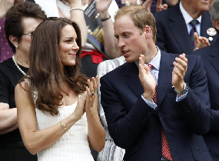
Introduction
MDSec Background
MDSec Short History
2007: Web Application Hacker’s Handbook, 1st Edition
2011: “ “ “ “ , 2nd Edition: now in blue.
Rest of 2011:
MDSec.net online training
MDSec.co.uk consulting (assessment services)
Webapp, Mobile Apps, Inf, SDLC, CREST, CHECK, other really good acronyms.

Slide 3
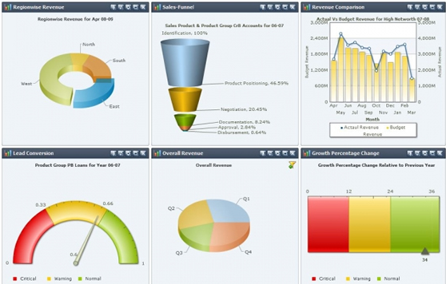
Introduction
The Talk’s Background
Task: create a vulnerability management system
Wanted to integrate with Fortify, others
Wanted metrics to feed into KPIs
Wanted to store all vulnerabilities by OWASP top 10
Assumption: all AppSec issues have an OWASP top 10 category
…we will never locate, track and resolve anything else?

Slide 4
Introduction
Background
Remember how tempting it is to think of easy wins
Some Easy Wins:
EW #1: “We’ll just encrypt everything”
EW #2: “Everything will be input validated”
EW #3: “It’ll all be picked up in the log files / audit trail”
EW #4: “We have firewalls”
EW #5: “We have application security systems”
(E?)W #6: “We did the OWASP Top 10, and the PCI Auditor went away”
Some Easy Wins in action…

Slide 5

Introduction
Messages from the Internet
2005: Message from a popular eCommerce Provider
“This site is absolutely secure. It has been designed to use 128-bit Secure Socket Layer (SSL) technology to prevent unauthorized users from viewing any of your information. You may use this site with peace of mind that your data is safe with us.”

Slide 6

Introduction
Messages from the Internet
2012: Message from a popular Cloud Provider
“We use unbreakable 256-bit AES encryption to ensure that the contents of your data is completely private and secure — only you and those you choose to share with may view the content of your files.”

Slide 7
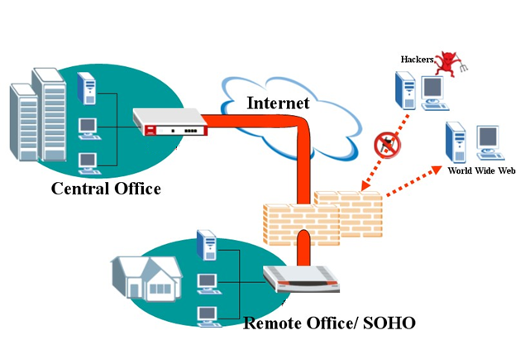
Introduction
Messages from the Internet
2012: Message from a popular Security Solutions Provider

Slide 8
Introduction
Background
Dangers of OWASP Top 10
“OWASP top 10” = “Application Security” for many internal teams.
Security products focus on it
PCI Auditors focus on it
Pentesters focus on it
Developers focus on it
We don’t want pentesting moved to the ‘Easy Wins’ Category!
Ref: Haroon Meer – “Penetration Testing Considered Harmful Today”
http://thinkst.com/stuff/44Con/44con-final.pdf

Slide 9
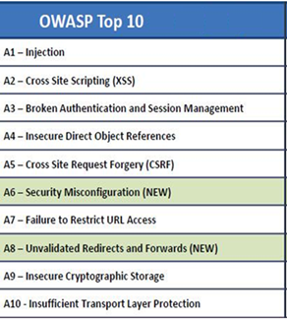
Introduction
Point of this talk
How many webapp vulnerabilities can you think of, which don’t fall into one of these categories?

Slide 10
Introduction
Point of this talk
Conclusion: It’s a good list..
Today’s talk: Some highlights from our tests which aren’t really described in the OWASP Top10 list + presentations.
In vulnerability terms, there’s nothing new here.
But:
Results of repeated pentesting / remediation cycles
Common occurrences, not one-offs.
This is a talk about methodology, not ‘Technology X’ or ‘Tool Y’

Slide 11
0
Simple Illustration: Replay Attack
Background
A system allows trading on real-time prices. Trading is sufficiently complex that by the time a user has decided on a purchase/sale, the price on the server may have changed.
Solution: Users’ prices are stored on the client side, but a checksum is included with the price. This allows the server to validate the price specified has not been tampered with.

Slide 12
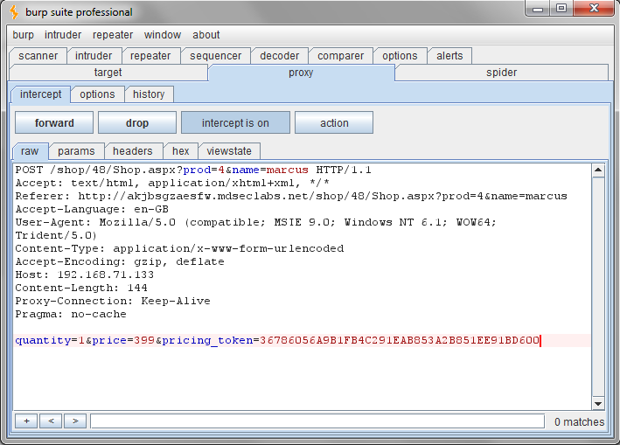
0
Simple Illustration: Replay Attack
(Trivial) Vulnerability
Users can either:
Find a cheap item, and use the checksum to buy an expensive item
Wait for an item to increase/decrease in price, then use the old checksum.

Slide 13
1
Recognising Inference Holes
Background
“Forgot Password” generated a secondary challenge.
Originally, a pentest had concluded that username enumeration was possible because if the username is not recognised, no challenge is generated.
Solution: Issue a “forgot password” challenge, and allow it to be answered, and then give a generic response “Thank you, recovery information has been sent to your email account”.

Slide 14

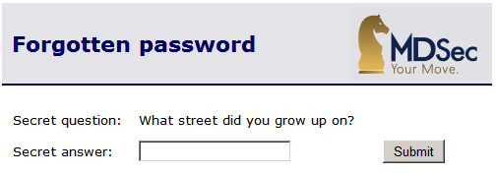
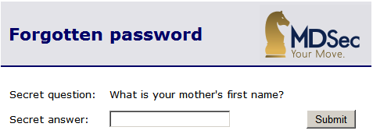
1
Recognising Inference Holes
The Vulnerability – User Enumeration after all…
The dummy challenge is going to be a randomly generated question.
Attacker can determine valid accounts by trying the same account twice.
Invalid user.

Slide 15
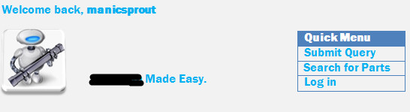
2
An Encryption Oracle
Background
RememberMe cookie is used to store an authentication token.
The RememberMe token contains meaningful data (random data, source IP, uid), and is protected using strong encryption.
ScreenName cookie stores screen name.
A security audit recommends that the ScreenName cookie is also encrypted.
Solution: Developers use the same strong encryption as for RememberMe. Whilst it may be overkill, it provides the same security benefit – Right?

Slide 16
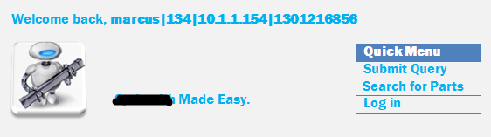
2
An Encryption Oracle
The First Vulnerability: an Encryption ‘Reveal’ Oracle
Users can now leverage the displayed screen name to decrypt the RememberMe cookie. We supply the RememberMe cookie value in place of the ScreenName cookie.
Interesting info-leakage, but not a serious vulnerability – yet..

Slide 17
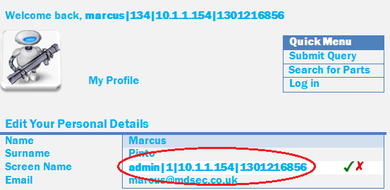
2
An Encryption Oracle
The Second Vulnerability: an Encryption ‘Write’ Oracle
Users can choose their own screen name! Selecting the screen name admin|1|10.1.1.154|1301216856 gives you an encrypted ScreenName cookie.
This encrypted value is a valid RememberMe token as well ...

Slide 18

3
Searching within Searches
Background
An application returns documents that match a user-supplied search term. As an incentive to attract users, they know their search is found but need to pay/sign up to view the document in question.
Solution: Documents appear in the search response, but there is access control which stops you actually viewing the document until you’re signed in.

Slide 19
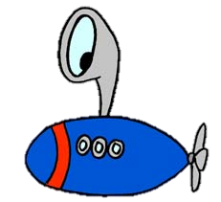
3
Searching within Searches
Vulnerability
An attacker could brute-force sensitive content within protected documents by searching one word or letter at a time, for example:
US Sanctions
US Sanctions planned
…
…
US Sanctions planned against DotNetNuke authors
Found on an internal wiki: some router configs. This time a substring match works!
Password
Password=
Password=a
Password=b
Password=ba…

Slide 20
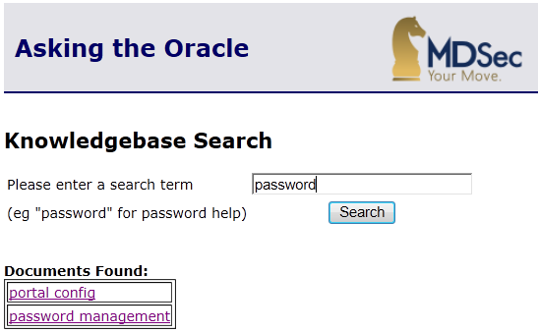
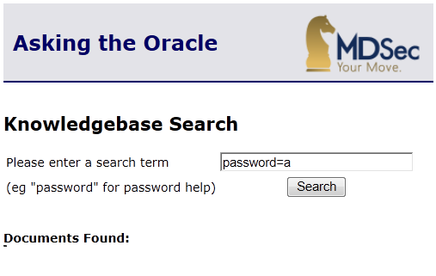
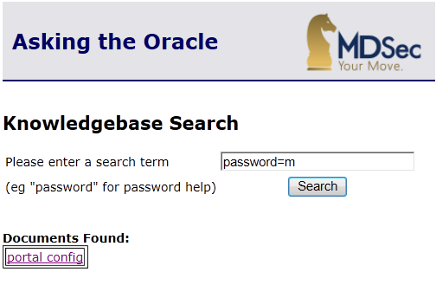
3
Searching within Searches
Vulnerability

Slide 21
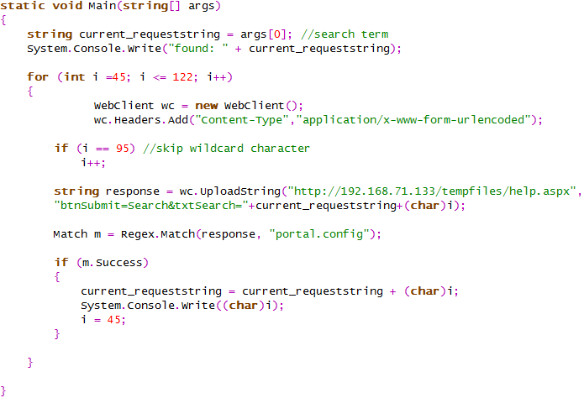
3
Searching within Searches
Vulnerability

Slide 22
4
Risky Registration, Part 1
Background
Users register using their email address
Email address is validated to be a well-formed email address
Usernames then derived from alphanumeric portions of the email address
marcus@mdsec.co.uk → marcusmdseccouk

Slide 23

4
Risky Registration, Part 1
Vulnerability one: some access to admin menus
Whilst trying for a username enumeration attack, we register the username:
ad@m.in
We were hoping to get a ‘user already exists’ error. Instead it creates us a user called “admin”. No bug?
..later we log into the site as our ‘admin’ user, and discover that we have created a second admin user, who can access all of the admin menus. This line is to blame:
if ($_SESSION[‘user']=‘admin’)
{
…
…

Slide 24

4
Risky Registration, Part 1
Vulnerability two: arbitrary user hijack!
Updating our user’s password resulted in the admin’s password being updated…
So it’s not just an admin special case, we can clone and take over any user:
Registering marcu@smdsec.co.uk would allow us to compromise the first record in the database with the (now non-unique) username marcusmdseccouk.

Slide 25
5
Risky Registration, Part 2
Background
A banking application allows existing banking customers to register to use online banking facilities. The workflow goes:
Challenge #1: First/Second Name, DoB
Challenge #2: Balance on last paper statement
Challenge #3: …
This should not allow immediate access to online banking
Solution: Issue a welcome pack and one-time password in the mail to the registered user’s home address.

Slide 26
5
Risky Registration, Part 2
The Vulnerability
When the user had been identified based on supplied information, the application created a session object to track the customer’s identify in the rest of the process. Developers reused an existing code component.
But this code component was used elsewhere in the app’s main banking functions to track the identity of authenticated users, and grant access to requests to view statements / make payments.
A malicious bank customer could perform the following attack:
Log in to the main banking application as normal, to obtain a valid session.
Switch to the registration function, and submit another customer’s personal information, causing the user identity object in their session to be overwritten.
Switch back to the main application and access the victim’s bank account.

Slide 27
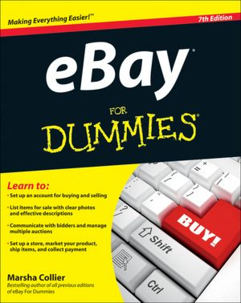
6
The Race Condition/ TOCTOU
Background
eBay allows you to use an offsite image when listing an item.
Offsite images are outside of eBay’s control.
Solution: when the user lists an item containing an off-site image, eBay checks it to make sure it’s a bona fide image, parsing it etc.

Slide 28

6
The Race Condition/ TOCTOU
The Vulnerability
eBay only checked at item creation. If the image is on your server, you can alter your server’s behaviour afterwards.
After successfully listing the item, the attacker issued a 302 Redirect when the image was requested.
The 302 Redirect was back to eBay, where you were logged in already.
The Redirect made you bid on the item.

Slide 29
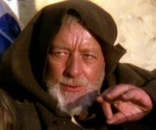
7
Escaping from Escaping
Background
This application executed OS commands using user-supplied data.
Solution: the developers considered all of the OS metacharacters which needed to be escaped, and prepended a backslash to any of those found. Their list was:
; | & < > ` space and newline

Slide 30
7
Escaping from Escaping
The Vulnerability
The developers forgot to escape the backslash itself.
If the attacker supplies
foo\;ls
Then the application will supply an extra backslash.. foo\\;ls
So the application’s backslash is escaped..
And the attacker’s semicolon isn’t.

Slide 31
8
A useful audit sanitiser
Background
Passwords were continually being found in log files.
Included unstructured logging eg query string, json arrays, error handling
Solution: Apply a mask to all logs to ensure entries following the string password= were masked. This used a Regex something like password=((?=.*\d)(?=.*[a-z])(?=.*[A-Z])(?=.*[@#&$%]).{6,20}) and filtered out matching text.

Slide 32
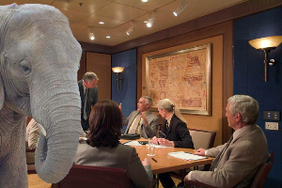
8
A useful audit sanitiser
Vulnerability: attacks are masked when triggering the security rule
/Search.aspx?docid=1passsword%3D%2520drop%20table%20users&order=5
Log entry:
[10/Apr/2011:12:39:11 +0300] "GET /Search.aspx?docid=1password=********&order=5
Application Log:
WARNING: Parsing error encountered processing docid 1password=********
Etc, etc.

Slide 33
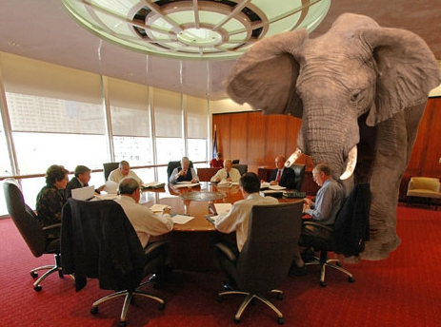
8
A useful audit sanitiser
Diatribe 1 – Snort:
Attacks show up under the highest priority signature they trigger:
GET /Search.aspx?Searchterm=a’%20or%201%3d1 HTTP/1.0
User-Agent: Mozilla/5.0 (/etc/passwd)
[**] [1:1122:6] WEB-MISC /etc/passwd [**] [Classification: Attempted Information Leak] [Priority: 2] 10/04-13:00:59.035764 192.168.***.***:48000 -> 192.168.***.**:80 ………
Diatribe 2 – SQL Auditing:
Bypass SQL Audit Log by invoking sp_password (Chris Anley, 2002)
http://www.cgisecurity.com/lib/advanced_sql_injection.pdf
Attack places the string sp_password at any location within an SQL Statement
-- 'sp_password' was found in the text of this event.
-- The text has been replaced with this comment for security
reasons.

Slide 34
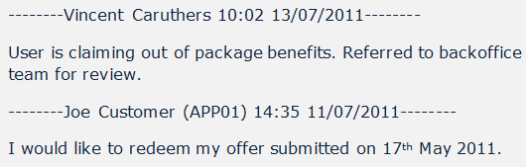

9
…and a log entry forger
Background
Users could submit feedback which was appended onto a ‘notes’ file.
Solution: User feedback is appended with date/timestamp, name etc.

Slide 35
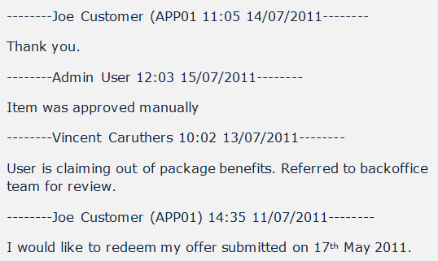
9
…and a log entry forger
Vulnerability
Users can submit a ‘feedback’ query of:
Thank you.%0a%0d%0a%0d--------Admin%20User%2012:03%2015/07/2011--------%0a%0d%0a%0dItem%20was%20approved%20manually

Slide 36

9
..back to our long-suffering app..
Remember this token?
marcus|134|10.1.1.154|1301216856
What if you register with a username of admin|1?

Slide 37
10
Anti-anti-automation
Sometimes we must allow a condition, but stop it being automated
User Enumeration in Authentication
Money can be made automating repetitive tasks
Refer and Earn
Site Registration Bonus
Standard solution is a CAPTCHA
→ So solving a CAPTCHA = earning money

Slide 38
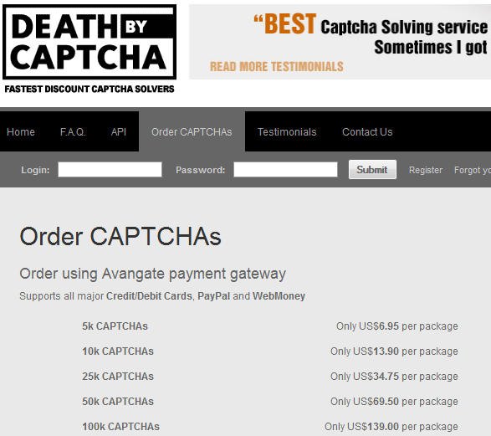
10
Anti-anti-automation
CAPTCHA: Making Money on the Internet
Option 1: the direct approach
Burp Extender developed by
www.idontplaydarts.com

Slide 39
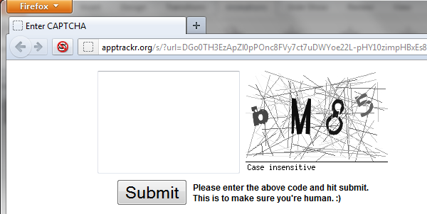
10
Anti-anti-automation
CAPTCHA: Making Money on the Internet
Option 2: an indirect approach. Serve a tempting file and get other people to answer ‘your’ CAPTCHAs.

Slide 40
11
Bad Practice: Why?
Background
We found a session token in the URL and wanted to prove it was bad practice.
Mitigations
Token was reassigned after logon; Session Fixation was not a practical attack.
Actually part of the site design. Pentest finding had been dismissed many times.
So (why) can it be bad practice?

Slide 41
11
Bad Practice: Why?
Session ID in the URL exploited using ‘Non-Forged’ Cross Site Requests
Injected a link to a resource (image, etc) hosted on attacker’s server.
The session token is sent in the Referer Field
GET /mostlyharmless.aspx HTTP/1.1
Host: mdattacker.com
User-Agent: Mozilla/5.0 (Windows NT 6.1; WOW64; rv:11.0) Gecko/20100101 Firefox/11.0
Accept: text/html,application/xhtml+xml,application/xml
Accept-Language: en-gb,en;q=0.5
Accept-Encoding: gzip, deflate
Referer: http://apugowebf.mdseclabs.net/auth/379/Home.ashx?SessionId__379=A3C166C0210A12BF3C99005A561C6098
Connection: keep-alive

Slide 42
Introduction
Any Others?
Also not on the top 10:
Clickjacking, Strokejacking, UI Redress
HTTP Parameter Pollution
Memory Management eg Integer Overflows, buffer overflow, ..
Arbitrary File Access (!)

Slide 43
Conclusion
So is the OWASP Top 10 ‘wrong’?
No.
But “top 10” != All issues
Stressing “top 10” focus may hide some interesting issues
MDSec Consulting has assessed many applications which have been ‘penetration tested’ before, possibly using a fixed/rigid methodology.
When done right, penetration testing is fun, creative and gives genuinely useful results

Slide 44
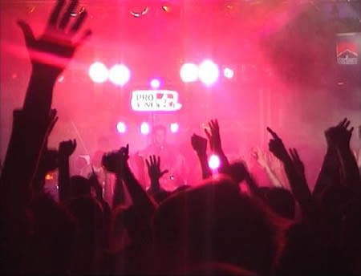
Introduction
Questions?

